Slide 1
Team Atlantas
Pranay Pandey (Leader)
Sakshi Dwivedi
Tanishq Chaudhary

Slide 2
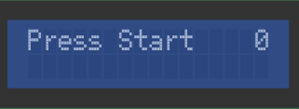
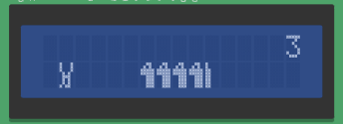
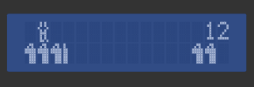
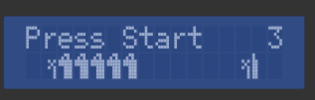
the Game
The game is an endless runner game where the rabbit(player) move on the ground and jumps up whenever dinosaur(obstacle) come close by to eat it.
The game starts asking the player to “Press Start” by pushing the button.
When started the rabbit keeps on moving. To avoid being eaten by the dinosaurs the player has to press a press button so that the rabbit jumps over the Dinosaur.
With every passing time the score (visible on the top right corner of the LCD display) increases. The aim of the player is to maximize the score which is done by keeping the rabbit alive for the maximum time.
If the player fails to do so the Dinosaur eats the rabbit and the game ends.
Player can see his final score at the top right corner.
To play again “Press Start”

Slide 3
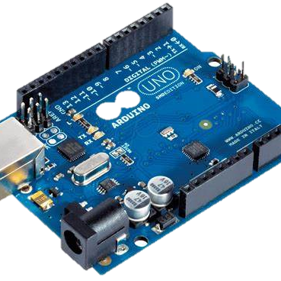


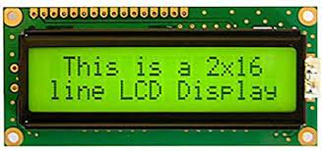
COMPONENTS REQUIRED
Arduino UNO
Push Button
16x2 LCD display
Potentiometer

Slide 4
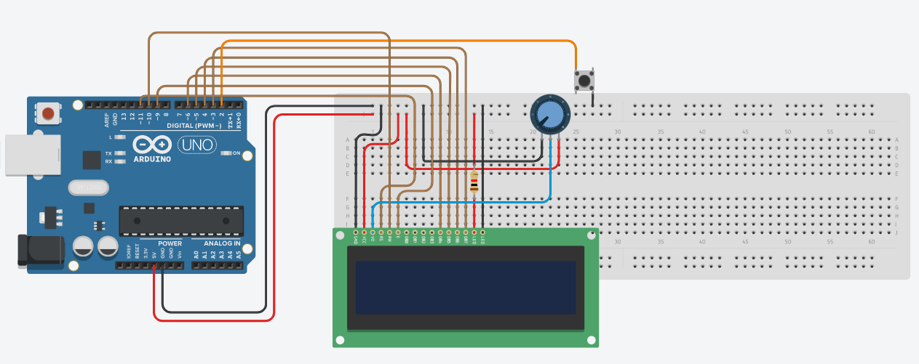
CONNECTIONS

Slide 5


IDEA AND APPROACH
To make our game we basically made three things :-
Making the character move up and down
Making the dinosaurs move towards the character
Ending the game once character gets eaten(collides)
While the purpose of potentiometer is just to adjust contrast for the LCD display
Before these processes we had to make the designs of the character and the dinosaurs. This was done by custom characters(array of 8 bytes)
For that we defined moving positions of the character, Jump position of the character and the design of the Dinosaur. We made the designs in an array called graphics and defined them as ids(0 to 6) using lcd. createChar() function.

Slide 6
To make character move, in order to see some animation effect we used 2 running and 2 jumping designs displayed one after the other.
When the push button is pressed, character is moved from lower row of display to upper row using the jumping designs.
The dinosaurs when appear from the right most corner are shifted one by one pixel wise, which gives makes dinosaurs move towards the character.
If the rabbit is touched by the dinosaur, our game will be frozen and the game ends displaying final score at top-right corner.
When push button is pressed gain the game starts again after clearing everything on the LCD display.

Slide 7

THANKS
Team Atlantas
Pranay Pandey
Sakshi Dwivedi
Tanishq Chaudhary

